Slide 1
Design patterns in Solidity

Slide 2
Design patterns
Contract Self Destruction
Factory Contract
Name Registry
Mapping Iterator
Sending ether from contract: Withdrawal pattern

Slide 3
Contract Self Destruction
Used for terminating a contract, which means removing it forever from the blockchain.
Once destroyed, it’s not possible to invoke functions on the contract and no transactions will be logged in the ledger.
Now comes the question “Why would I ever destroy my contract?”.
There are multiple reasons, such as dealing with timed contracts or contracts that must be terminated once a milestone has been reached or contracts that are obsolete.

Slide 4
Some things to keep in mind when dealing with a contract that has been destroyed:
Transactions will fail
Any funds sent to the contract will be lost
In order to prevent the loss of funds you should remove all references of dead contracts and/or call get() before sending funds to make sure the contract still exists.

Slide 5
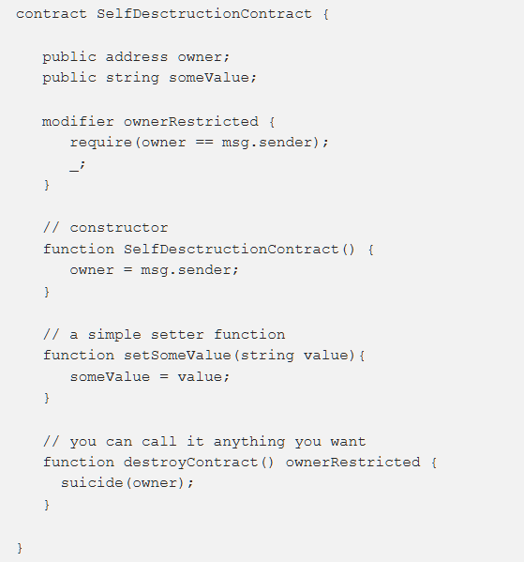

Slide 6
Factory Contract
Factory contract is used to create and deploy “child” contracts. Those child contracts can be referred to as “assets” which in the real life could represent, say, a house or a car.
The factory is used for storing the child contracts’ addresses so that they can be extracted whenever necessary.
By storing them in the contract they remain in the blockchain and they are pretty much safe there, while data corruption in your database might wipe the asset contracts’ addresses which will lead to losing references to those contracts.
A common use case for the Factory contract is selling assets and keeping track of those assets (eg. who is the owner). To sell an asset you add the payable modifier to the functions responsible for deploying the assets.

Slide 7
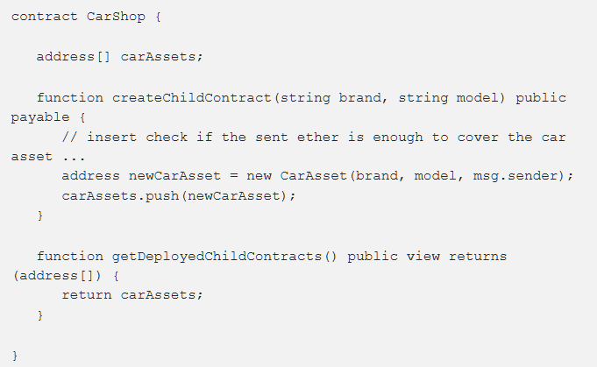
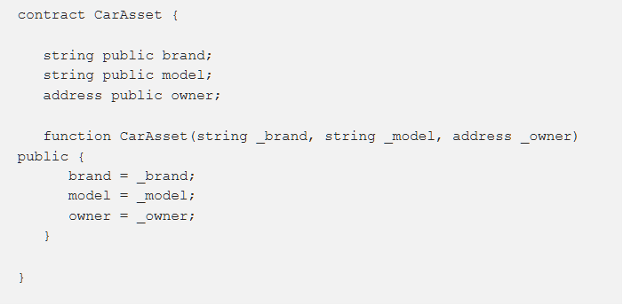

Slide 8
The line address newCarAsset = new CarAsset(...) fires a transaction which deploys the child contract and returns the address for that contract.
The only connection between the factory contract and the assets is the variable address[] carAssets;
The addresses of the child contracts is the only connection so it must be stored.

Slide 9
Name Registry
Imagine you are building a DApp which has a dependency on multiple contracts
It would be hard to keep all those addresses inside your app’s code. There might be an addresses change over time or even more annoying, while developing you are deploying all those contracts every time you make changes and you have to keep track of their addresses.
This is where Name Registry comes into play. This pattern allows you to only keep the address of one contract, instead of tens, hundreds or even thousands, as your DApp grows in scale.
It works by storing a mapping contract name => contract address so each address can be looked up from within the DApp by calling getAddress(“ContractX").
The benefit of storing names mapped to addresses is that with the introduction of new versions of some contracts the DApp will not be affected in any way since the only thing we modify is just the address of the mapping.

Slide 10
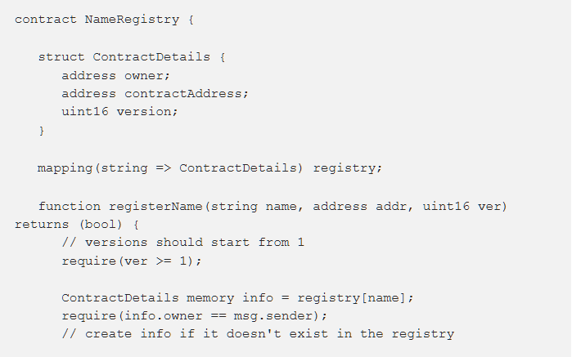
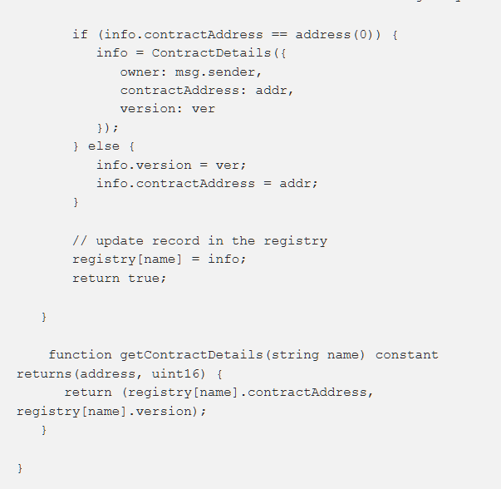

Slide 11
Mapping Iterator
Many times we need to iterate a mapping, but since mappings in Solidity cannot be iterated and they only store values, the Mapping Iterator pattern turns out to be extremely useful.
Some things to keep in mind are that as elements count goes up the complexity of iteration will increase, as well as the storage cost, so avoid iterating when possible.

Slide 12
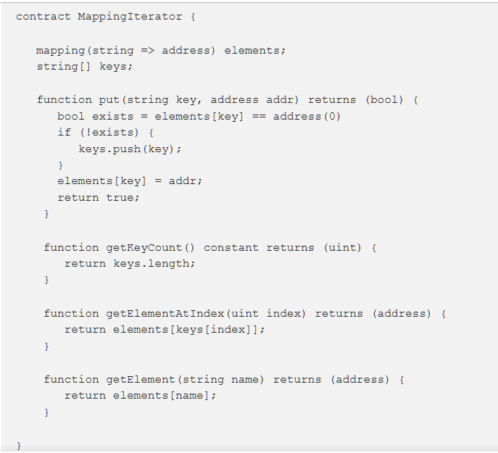

Slide 13
Withdrawal Pattern
Imagine you sell car tires. All the tires you’ve sold turn out to be faulty in some fashion and you offer a refund to everyone who paid for them.
Let’s say you keep track of all buyers in a contract and you have a refund function which iterates through your buyers list and sends back the money to each one of them.
You have a choice - use buyerAddress.transfer() or buyerAddress.send() .
The difference between both functions is that transfer() will throw an exception if something goes wrong with the transaction while send() will not throw but simply return a boolean false .

Slide 14
Why is this important? Let’s say most buyers are external accounts (i.e. individuals), but some buyers are other contracts (perhaps businesses). Assume that among those buyer contracts there is one contract whose developers made a mistake in its fallback function and it throws an exception when invoked (fallback functions are default functions in contracts that are invoked if a transaction is sent to the contract without specifying any methods). Now as soon as we invoke contractWithError.transfer() in our refund function an exception will be thrown and iteration will be stopped. Therefore, transaction is reverted and none of the buyers gets their refund. They are blocked.

Slide 15
While refunding all buyers in one invocation can be implemented using send() , it is instead better to expose withdrawFunds() function which will refund callers on demand, individually. Thus, the erroneous contract will not block the rest of the buyers and will only receive funds when the fallback function code is fixed.

Slide 16
